Slide 1
Chapter 5
Objects Oriented Programming Concepts
ITec4043 : Object Oriented Programming

Slide 2
Outline
Inheritance
Encapsulation
Method overloading and overriding
Polymorphism
Abstraction and modularization
Abstract classes and Interfaces

Slide 3
Introduction to Inheritance
Inheritance is one of the primary capabilities of OOP.
Inheritance is a form of software reuse in which a new class is created by absorbing an existing class’s members and embellishing them with new or modified capabilities.
The idea of inheritance is that you can create new classes that are built on existing classes.
When you inherit from an existing class, you reuse ( or inherit) its methods and fields and you add new methods and fields to adapt to your new class to new situations.

Slide 4
Introduction to Inheritance
Defining a new class based on an existing class is called derivation.
The new class, or derived class, is referred to as a direct subclass of the class from which it is derived.
The original class is called a base class or superclass because it forms the base for the definition of the derived class.
You can also derive a new class from a derived class, which in turn was derived from some other derived class, and so on.
Java supports inheritance by allowing one class to incorporate another class into its declaration. This is done by using the extends keyword. Thus, the subclass adds to (extends) the superclass.
The additional members that you define in the new class establish what makes a derived class object different from a base class object.

Slide 5
Introduction to Inheritance(Example :Facebook main Page)
Inheritance allows us to define one class as an extension of another.
Example: Facebook newsfeed: The news feed is the list of messages that should appear on screen when a user opens the application’s main page.
initially, we will only have two types of posts appearing in our news feeds:
Text posts which we call messages, and
Photo posts consisting of a photo and a caption

Slide 6
Introduction to Inheritance(Example :Facebook main Page contd.)
MessagePost inherits from class Post
PhotoPost inherits from Post
Using Java’s syntax:
class MessagePost extends class Post
class PhotoPost extends class Post
class Post is called Superclass or parent class.
MessagePost and PhotoPost are called child classes or Subclasses.

Slide 7
Syntax to create Inheritance relationships
Syntax :
class subclass-name extends superclass-name{
//body of class
}
The subclass inherits from the superclass.
In Java we say the subclass extends the superclass
The subclass inherits member fields and member methods defined inside the superclass.

Slide 8
Super-classes and Sub-classes and the relationship between them
A superclass tends to be “more general” and subclasses are “more specific”.
Every subclass object is an object of its superclass and one superclass can have many subclasses.
The general form of a class declaration that inherits a superclass is as follows:

Slide 9
Inheritance Hierarchy Example

Slide 10
Member Access and Inheritance(Access Modifiers)
Access Modifiers control access to a class’s fields and methods.
• Java provides three kinds of access modifiers
Public
Private
Protected
• public : a class’s public members are accessible everywhere in a program
• private: a class’s private members are accessible only within the class itself.
• So What Happens in inheritance ( Access levels control who sees what) ?
public members are inherited
private members are not inherited
• Do we have another level of access control ?
Yes : protected

Slide 11
Protected Members
Using the access modifier protected offers an intermediate level of access between public and private.
A class’s protected members can be accessed by members of that class, and by all classes defined inside the same package.
A superclass’s protected members can be accessed by
Members of that superclass
Members of its subclasses and
Members of other classes in the same package
Protected members have upto package level access

Slide 12
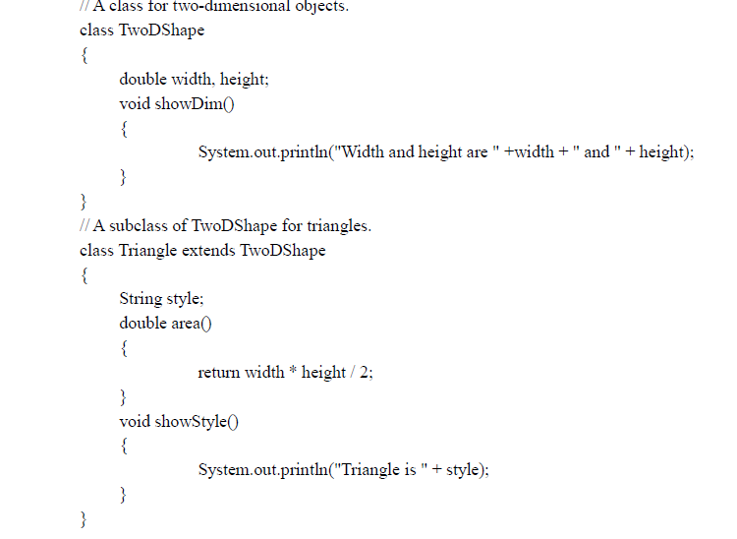
Cont.….

Slide 13
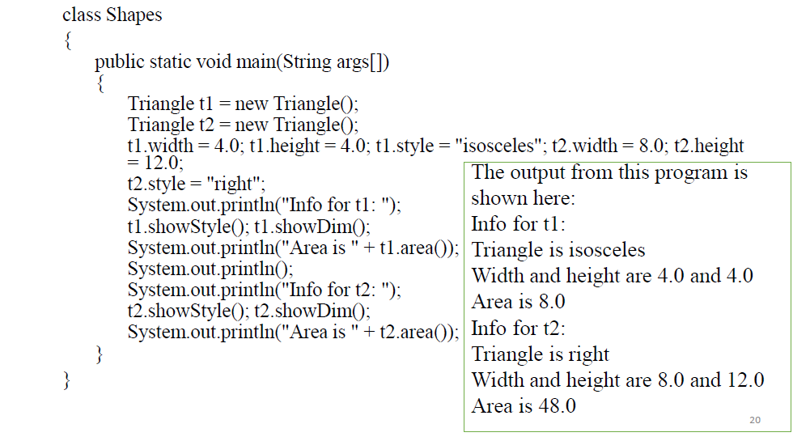
Cont.…

Slide 14
Benefit of Inheritance
It helps with code reusability -
A superclass's code can be used for multiple subclasses. That eliminates code redundancy and makes debugging and upgrading easier.
A programmer can use an existing class to easily create a new subclass (no need to "reinvent the wheel.").
Smaller modules (because classes are split into super classes and subclasses).

Slide 15
Encapsulation
Encapsulation means to design, produce, and describe software so that it can be easily used without knowing the details of how it works.
In support of encapsulation, OOP’s classes and objects provide two major benefits:
Linking data with the code that changes the data.
Providing the means by which access to members can be controlled.
Public members can be freely accessed by code defined outside its class
Private members can be accessed only by other members defined in its class.
It is through the use of private members that access is controlled.
Restricting access to a class’s members helps prevent the misuse of an object.

Slide 16
Encapsulation(Examples)
class MyClass{
public int alpha; // public access
private int beta; // private access
int gamma; // default access ( essentially public)
}
A method can also be declared as public or private (rarely used).
If a method is private it can’t be called outside its class.
Use private methods when the implementation inside require special protocol or calling order

Slide 17
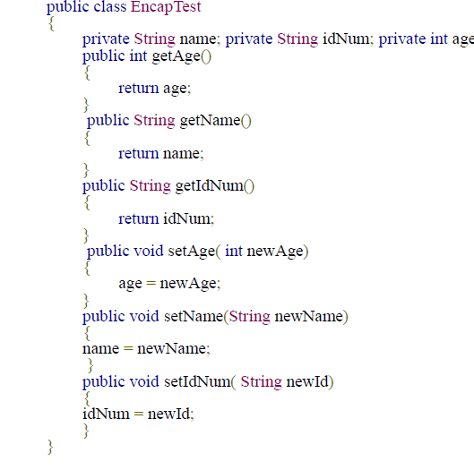
Encapsulation(Examples)

Slide 18
Subtyping: Superclass References and Subclass Objects
Since Java is a strongly typed language, we know that type compatibility is strictly enforced.
Therefore, a reference variable for one class type cannot normally refer to an object of another class type.
In general, an object reference variable can refer only to objects of its type.
Exception occurs in Subtyping: a reference variable of a superclass can be assigned to any subclass derived from that superclass.
The type defined by a subclass definition is a subtype of the type of its superclass

Slide 19
Method Overriding and Method Overloading
In a class hierarchy, when a method in a subclass has the same
Return type and
Method signature then
The method in the subclass is said to override the method in the superclass.
When an overridden method is called from within a subclass, it will always refer to the version of the method defined by the subclass.
The version of the method defined by the superclass will be hidden.
Method overriding occurs only when the return types and signatures of the two methods are identical. If not, then the two methods are simply overloaded

Slide 20
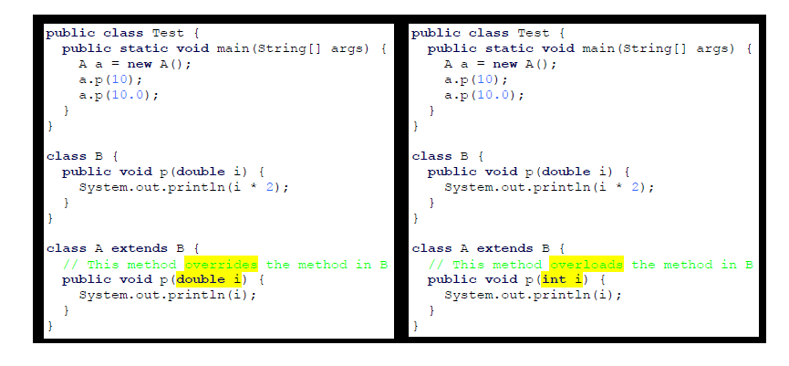
Overriding vs. Overloading

Slide 21
Introduction to Polymorphism
The ability for the same code to be used with several different types of objects and for that code to behave differently depending on the actual type of object used is called Polymorphism.
“Polymorphism” comes from the Greek words “poly” (many) +“morph”( form)
Polymorphism is made possible by the fact that the type of a reference variable ( one that refers) to an object does not have to exactly match the type of object it refers to.
The ability for superclass variables to refer to subclass objects allow us to write flexible code that can interact with many type of objects in the same way.

Slide 22
Basis for Polymorphism
Polymorphism is a powerful feature built on top of inheritance hierarchies through the following two concepts:
Subtyping and
Method Overriding
Why polymorphism?
Polymorphism is essential to object-oriented programming for one of the following reason:
It allows a general class to specify methods that will be common to all of its derivatives, while allowing subclasses to define the specific implementation of some or all of those methods.
Overridden methods allow Java to implement the “ one interface, multiple methods” aspect of polymorphism.

Slide 23
How is polymorphism implemented ?
Java uses Subtyping to resolve calls to overridden methods at run time. Here is how:
When an overridden method is called through a superclass reference, Java determines which version of that method to execute based upon the type of the object being referred to at the time the call occurs.
When different types of objects are referred to, different versions of an overridden method will be called.
It is the type of the object being referred to (not the type of the reference variable) that determines which version of an overridden method will be executed.

Slide 24
Example: Polymorphism
class Sup{
String who(){
return “this is Sup”;
}
}
class Sub1 extends Sup{
String who(){
return “this is Sub one”;
}
}
class Sub2 extends Sup{
String who(){
return “this is Sub2”;
}
}
class polyy{
public static void main(String[] args){
Sup superob = new Sup();
Sub1 subob1 = new Sub1();
Sub2 subob2 = new Sub2();
Sup supRef;
supRef = superob;
System.out.println(supRef.who());
supRef = subob1;
System.out.println(supRef.who());
supRef = subob2;
System.out.println(supRef.who());
}
}

Slide 25
Abstraction and Modularization
To maintain an overview in complex programs, we try to identify subcomponents that we can program as independent entities.
Then we try to use those sub-components as if they were simple parts, without being concerned about their inner complexities.
In OOP these components and sub components are objects.
Abstraction: is the ability to ignore details of parts, to focus attention on a higher level of a problem.
Modularization: is the process of dividing a whole into well defined parts that can be built and examined separately and that interact in well defined ways.

